Slide 1
Reaction/diffusion equations and oscillating patterns
Group Members: Rongkun Wang, Dan Liu
Instructor: Professor Zachary Ulissi
Notes:
Main title: 40 pt. Arial
Presenter Name: 16 pt. Arial
Presenters Title: 16 pt. Arial Italic

Slide 2
CONTENT
Fitzhugh-Nagumo Equation of a Reaction-Diffusion System
Alan Turing Animal Coat Pattern Formation
Wood Texture Image Processing

Slide 3
Fitzhugh - Nagumo Equation

Slide 4
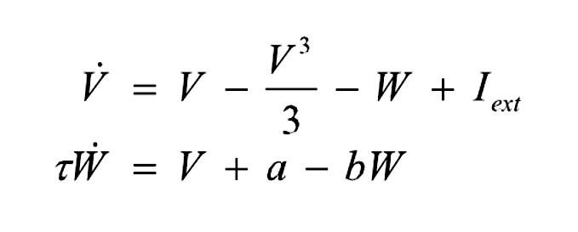
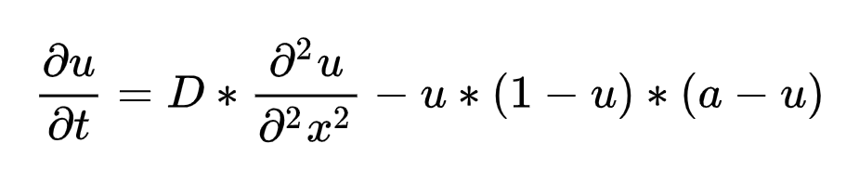
Fitzhugh-Nagumo Equation
The FitzHugh–Nagumo model ( FHN ), named after Richard FitzHugh (1922–2007) who suggested the system in 1961 and J. Nagumo et al . who created the equivalent circuit the following year, describes a prototype of an excitable system (eg, a neuron ). And the equations to describe the dynamical system is:
PDEs

Slide 5
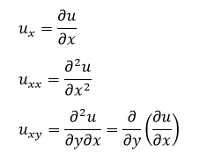
Partial Differential Equations (PDEs)
A partial differential equation (or briefly a PDE) is a mathematical equation that involves two or more independent variables, an unknown function (dependent on those variables), and partial derivatives of the unknown function with respect to the independent variables.
Usually, In PDEs, we denote the partial derivatives using subscripts, such as:

Slide 6
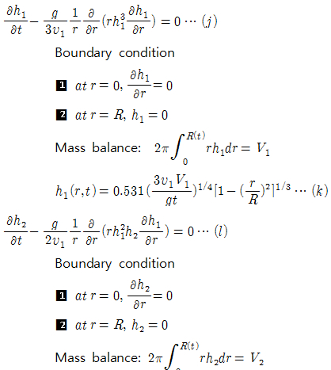
Partial Differential Equations (PDEs)
Given the boundary conditions, we may be able to solve the PDEs analytically.
Solve the PDEs with:
COMSOL
PYTHON

Slide 7
CASE 1: Alan Turing Animal Coat Pattern Formation

Slide 8
Alan Turing Animal Coat Pattern Formation
A reaction-diffusion system models the evolution of one or several variables subject to two processes: reaction (transformation of the variables into each other) and diffusion (spreading across a spatial region). Some chemical reactions can be described by this type of model, but there are other applications in physics, biology, ecology, and other disciplines.
We simulate a system that has been proposed by Alan Turing as a model of animal coat pattern formation. Two chemical substances influencing skin pigmentation interact according to a reaction-diffusion model. This system is responsible for the formation of patterns that are reminiscent of the pelage of zebras, jaguars, and giraffes.

Slide 9
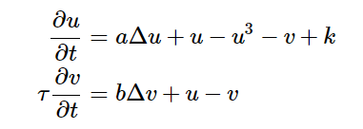
Alan Turing Animal Coat Pattern Formation
This case is simulated with the following PDEs over the domain of E=[-1,1]²:
The variable u represents the concentration of a substance favoring skin pigmentation, whereas
v represents another substance that reacts with the first and impedes pigmentation.
Reference: IPython Cookbook - 12.4. Simulating a partial differential equation — reaction-diffusion systems and Turing patterns (ipython-books.github.io)

Slide 10
Step 1: Create a New File
In COMSOL, there are several PDE solvers. Here I used General Form PDE.
Here are the steps:
Set up a new file in a 2D model, and Add General Form PDE solver
add Time Dependent study
Set parameters: a = 2.8e-4 b = 5e-3 tau = .1 k = -.005
Set Unit System as None
Add Square in Geometry, and set the side length as 0.02. Then set (0,0) as the center of the square

Slide 11
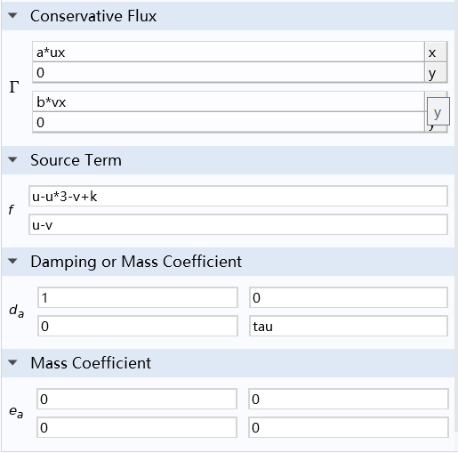
Step 2: Settings in General Form PDE Solver
In General Form PDE solver:
Set the value of Conservative Flux τ : (a * ux, 0), (b * vx, 0)
Set the value of Source Term f : u-u*3-v+k, u-v
Set the value of Damping or Mass Coefficient da : (1, 0), (0, tau)
Set the value of Mass Coefficient ea : (0, 0), (0, 0)
Set initial values: u = 0, ∂u/∂x = 0, v = 0, ∂u/∂x = 0
Add Dirichlet Boundary Condition, and select all boundaries

Slide 12
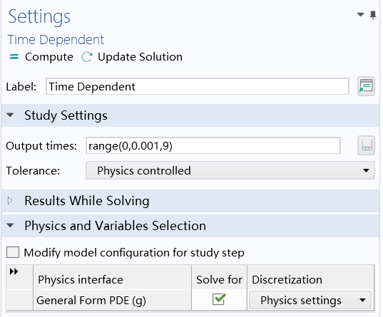
Step 3: Time Settings
In Time Dependent setting page, input ‘range (0, 0.001, 9)' as Output times.
That means COMSOL will compute from 0s to 9s, and the step of time is 0.001.

Slide 13
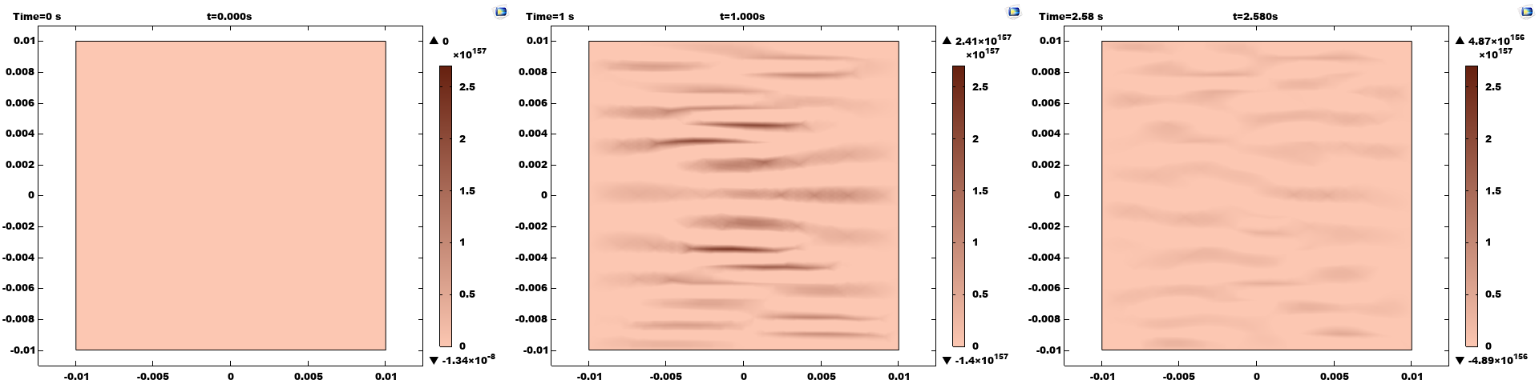
Alan Turing Animal Coat Pattern Formation
From 0.000s to 2.580s

Slide 14
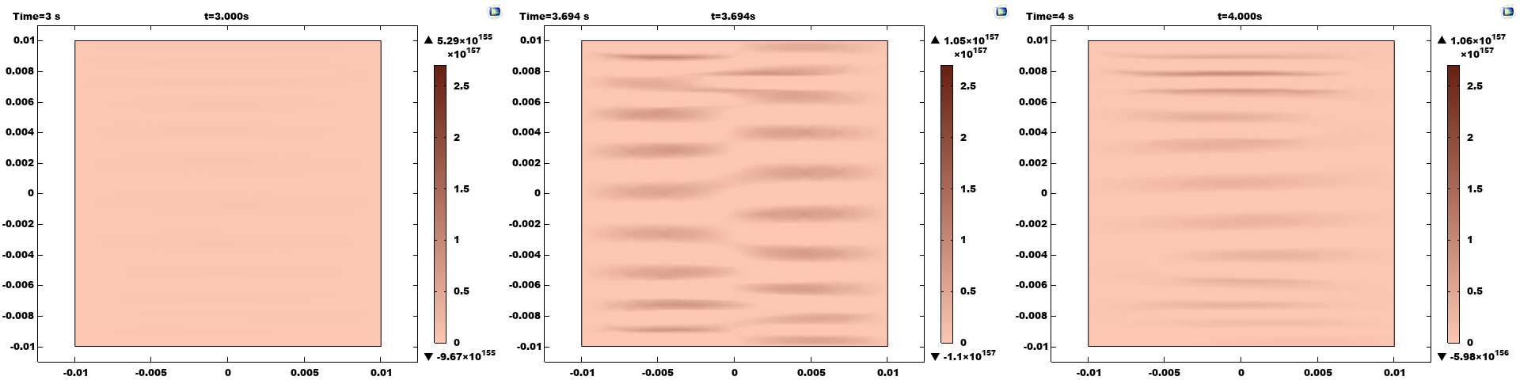
Alan Turing Animal Coat Pattern Formation
From 3.000s to 4.000s

Slide 15
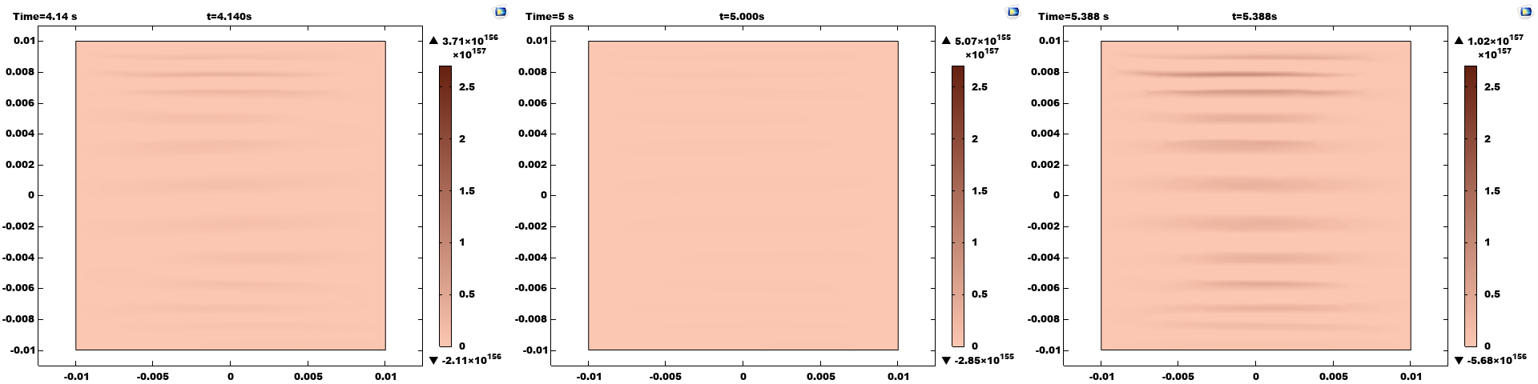
Alan Turing Animal Coat Pattern Formation
From 4.140s to 5.388s

Slide 16
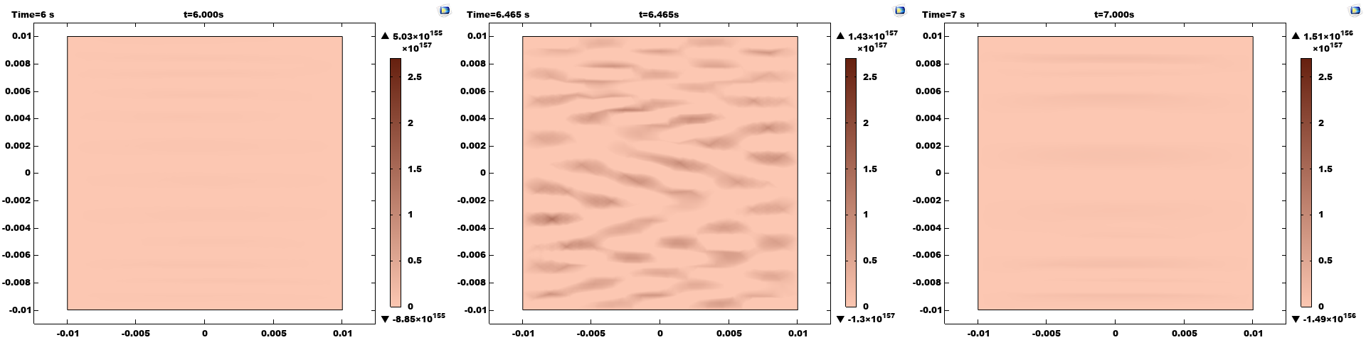
Alan Turing Animal Coat Pattern Formation
From 6.000s to 7.000s

Slide 17
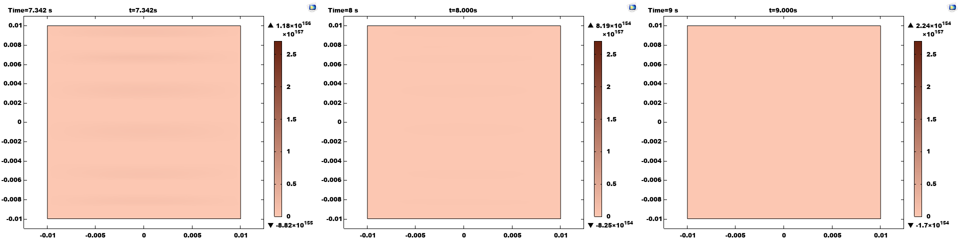
Alan Turing Animal Coat Pattern Formation
From 7.342s to 9.000s

Slide 18
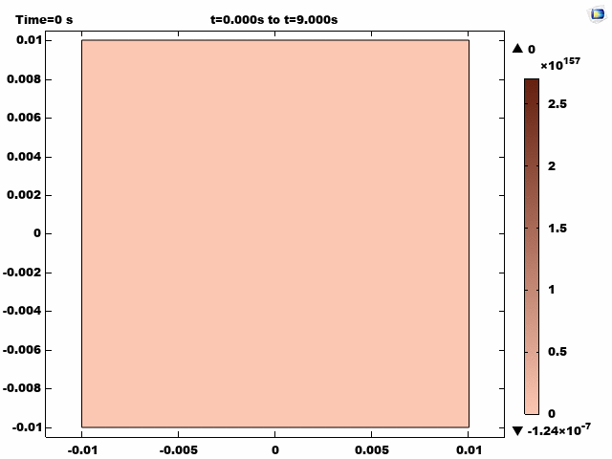
Alan Turing Animal Coat Pattern Formation

Slide 19
CASE 2: Wood Texture Image Processing

Slide 20
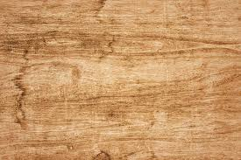
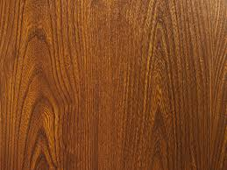
Wood Texture Image Processing
Wood texture has the information about the growth of trees, and it is the direct way to know about trees for human beings. Aiming at this kind of natural phenomenon, the Fitzhugh-Nagumo Equation of a reaction－diffusion system can be used to explore the wood texture images.

Slide 21

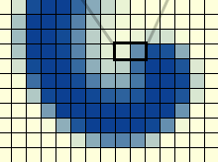
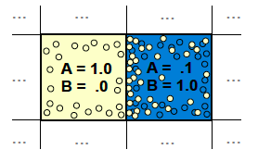
Wood Texture Image Processing
Here we use the Gray-Scott model to simulate the two chemicals’ reaction and diffusion on a 2D grid.
Use i and j to represent the grid

Slide 22
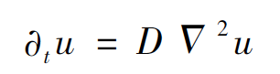
Wood Texture Image Processing
The diffusion equation can be denoted as:
The distribution of the chemicals
U(x,t) is decided by x and t
Laplacian operate: these are 2D laplacian functions, which give the difference between the average of nearby grid cells and this cell.
Diffusion coefficient: diffusion rate of the chemicals

Slide 23
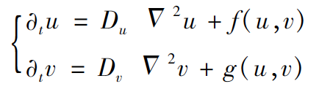
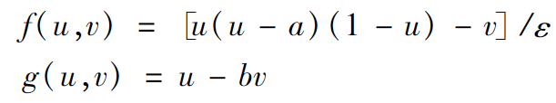
Wood Texture Image Processing
The Fitzhugh-Nagumo Equation of a reaction－diffusion system is (we assume that there are two chemicals diffuse across the grid):
Reaction Term
Diffusion Term

Slide 24
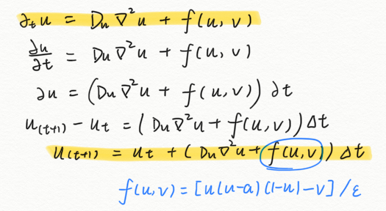
Wood Texture Image Processing
The discrete reaction-diffusion update equations are:
The same calculation process of chemical v.

Slide 25
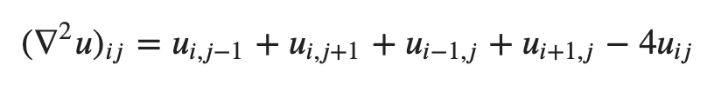
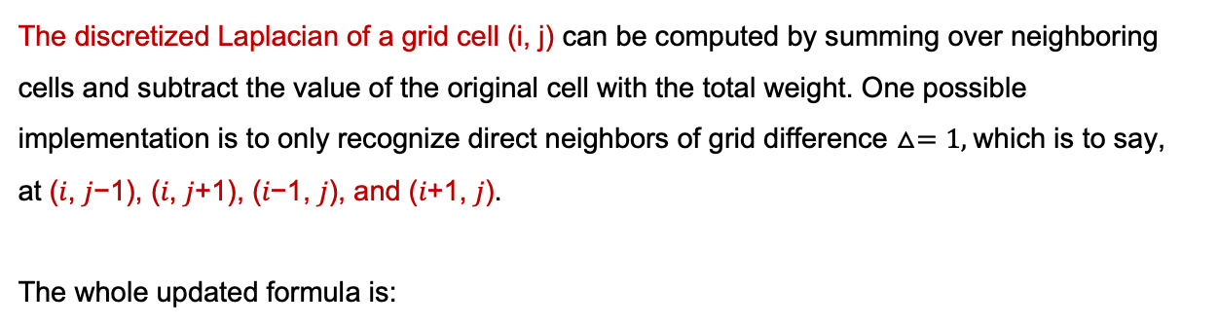
Step 1: Discrete Laplacian
The discretized Laplacian of a grid cell (i, j) can be computed by summing over neighboring cells and subtract the value of the original cell with the total weight. One possible implementation is to only recognize direct neighbors of grid difference $△=1,$which is to say, at (𝑖, 𝑗−1), (𝑖, 𝑗+1), (𝑖−1, 𝑗), and (𝑖+1, 𝑗).
The whole updated formula is:

Slide 26
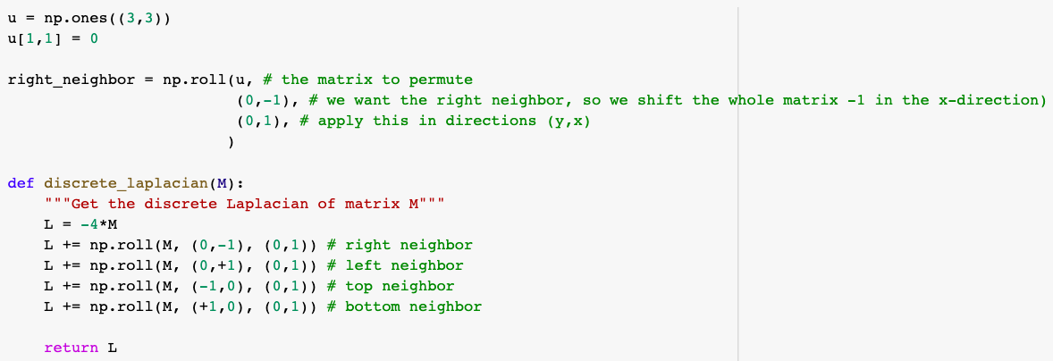
Step 1: Discrete Laplacian

Slide 27
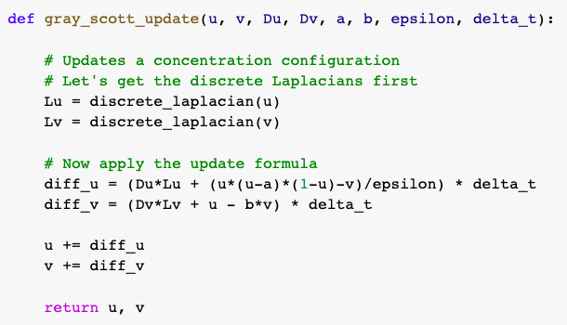
Step 2: Apply the Updated Formula

Slide 28
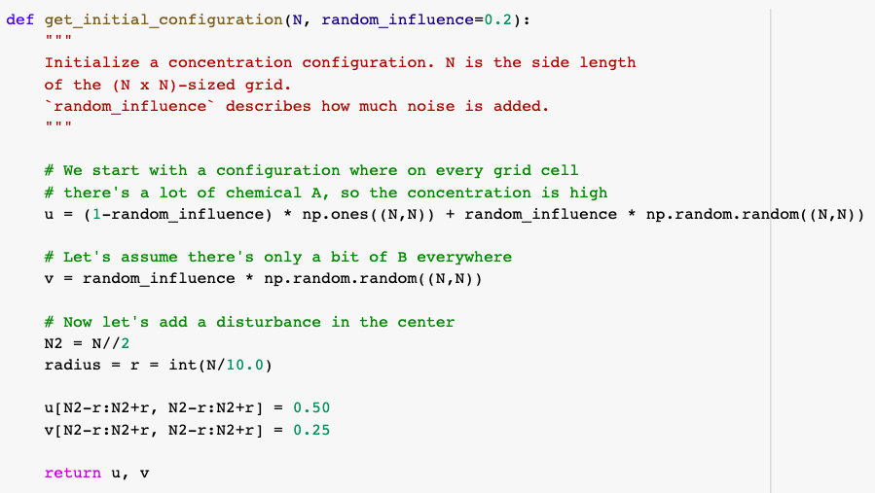
Step 3: Choose Initial Condition
Here we choose to build up a homogeneous distribution of chemicals with a small disturbance which can then produce some patterns. We can also add a bit of noise on them as the followings:

Slide 29
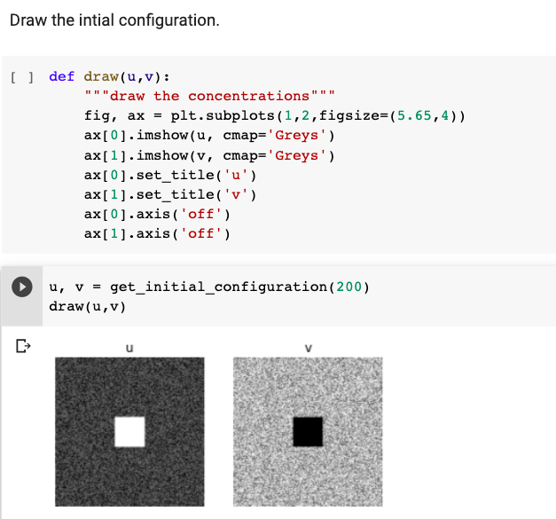

Slide 30
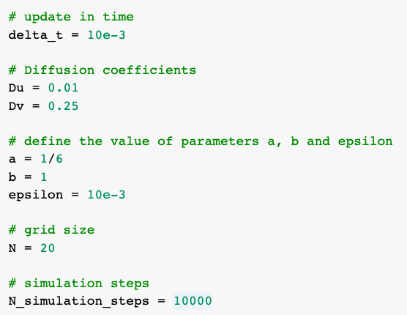
Step 4: Define the Parameters
Those parameters (a, b, epsilon, Du, Dv…) have great influence on the simulation patterns. If we change the parameters, the patterns would be different.

Slide 31
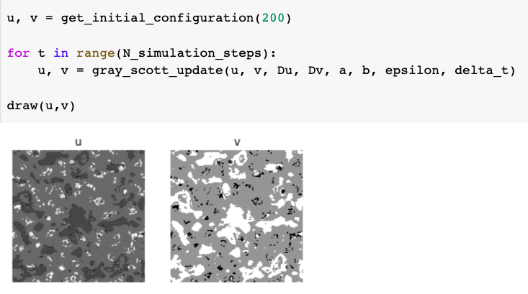
Step 5: Simulation

Slide 32
Fitzhugh-Nagumo Equation
PDEs

Slide 33
Thank you !

